Slide 1



Furniture Dashboard
View in Power BI
Last data refresh:
5/16/2023 3:14:37 PM UTC
Downloaded at:
5/16/2023 3:15:38 PM UTC

Slide 2
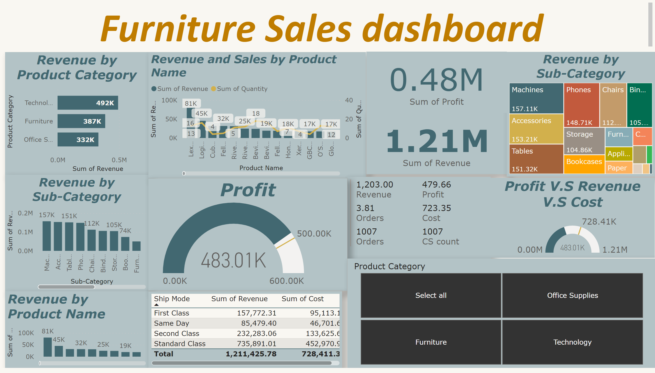
Product Dashboard
Notes:
Revenue by Product Category
No alt text provided
Revenue by Sub-Category
No alt text provided
Revenue by Product Name
No alt text provided
Revenue and Sales by Product Name
No alt text provided
card
No alt text provided
Revenue by Sub-Category
No alt text provided
multiRowCard
No alt text provided
Profit
No alt text provided
Profit V.S Revenue V.S Cost
No alt text provided
tableEx
No alt text provided
slicer
No alt text provided
textbox
No alt text provided
card
No alt text provided

Slide 3
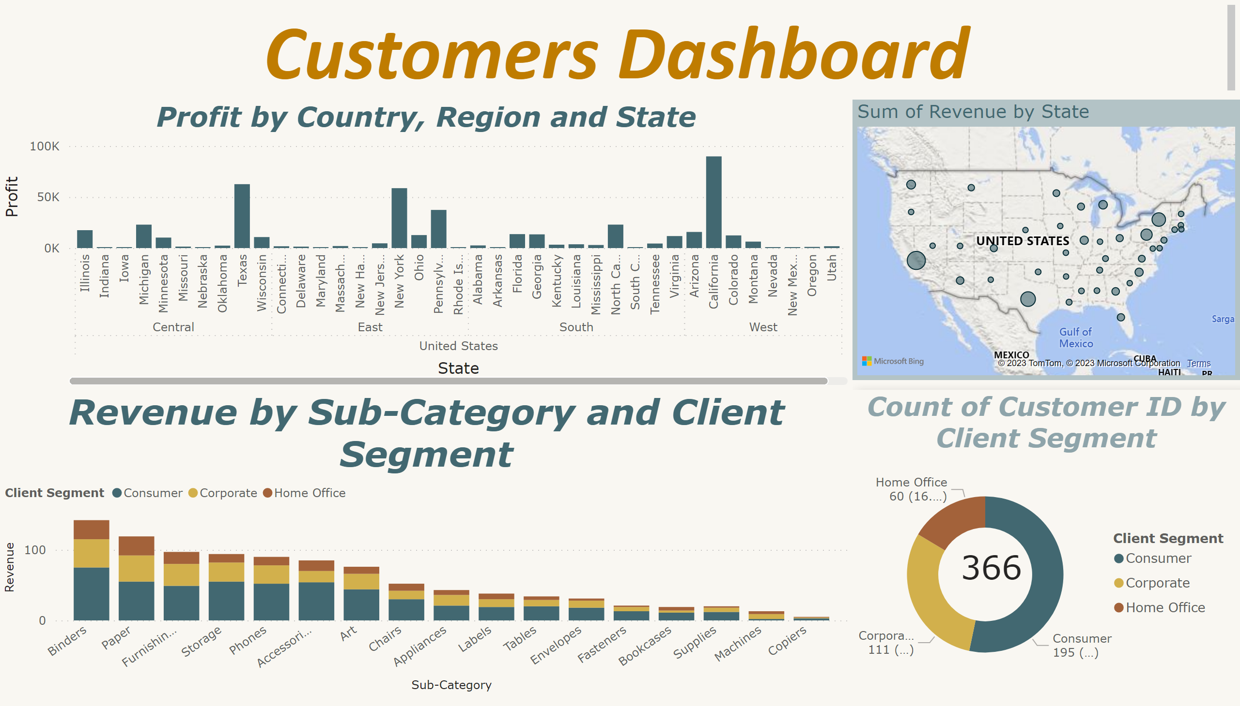
Customers dashboard
Notes:
donutChart
No alt text provided
map
No alt text provided
card
No alt text provided
clusteredColumnChart
No alt text provided
textbox
No alt text provided
columnChart
No alt text provided

